Slide 1
Oneness the dream and goal
From time immemorial

Slide 2
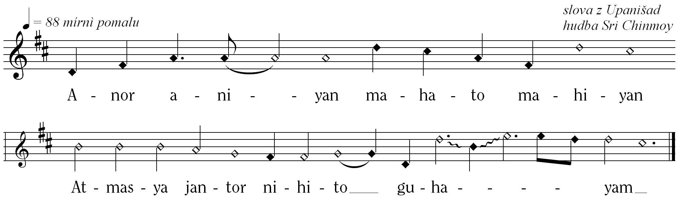
Anor aniyan, mahato mahiyan
Smaller than the smallest, Larger than the largest,
The soul breathes in the secret heart of man

Slide 3
“Mine after all may be a utopian dream. But being innocent,
I thought I might indulge in it
until I go to the land of dreams and
sleep there with all the dreamers
of past and future times.”
-Thomas Jefferson – Light and Liberty (check exact quote)

Slide 4
Supreme had a dream, the Usa,
the league of nations
the United Nations –Heart home of the world body
Oneness –Home., Oneness –world
May not be in this form – but at present the closest-
get exact quote.

Slide 5
“I feel the United Nations is not a mere building, it is not an ordinary building,
but it is a heavenly building where
truth, light, peace and bliss can be found,
a place that will be flooded with light, peace and bliss. It is a torch bearer of ultimate truth
– and the ultimate truth is
the universal peace”
  – Sri Chinmoy, July 30th, 1974

Slide 7
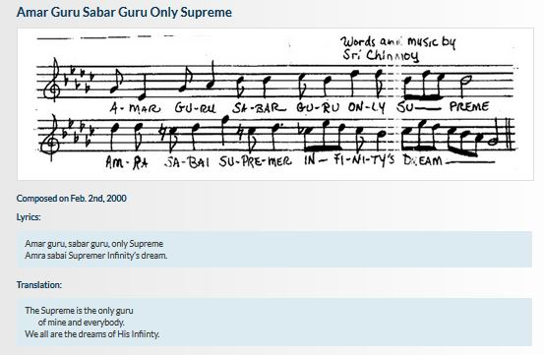

Slide 8
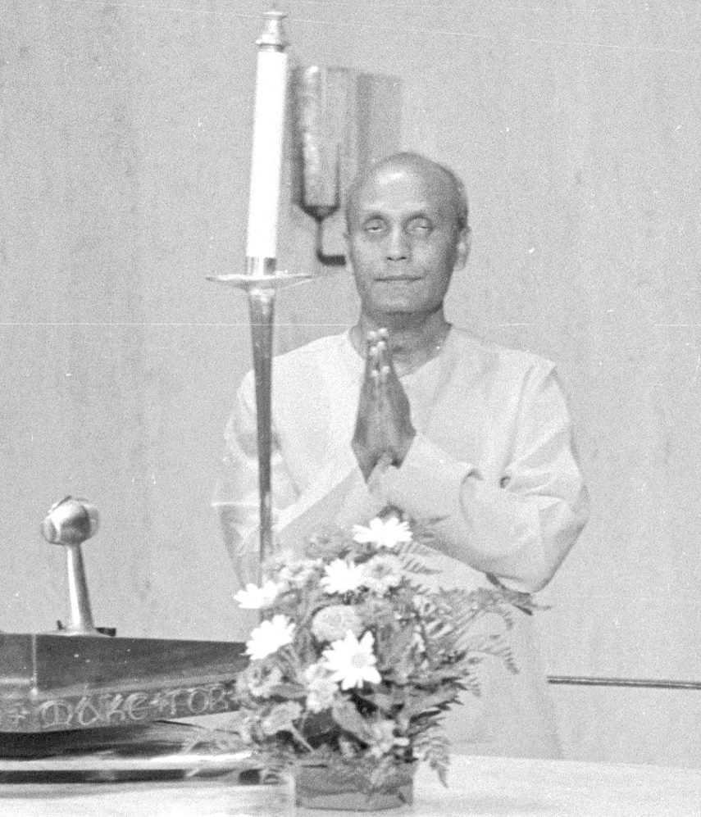
Lyrics:
Amar guru, sabar guru, only Supreme Amra sabai Supremer Infinity’s dream.
Translation:
The Supreme is the
only guru of mine
and everybody.
We all are the dreams of His Infinity.
.

