Slide 1
Observance of Two 50th Anniversaries Related to the United Nations
50th Anniversary of Sri Chinmoy’s First Talk to the UN community in 1968
50-Concert Tour offered by Sri Chinmoy to commemorate the 50th Anniversary of the UN in 1995
And 700 “Peace Blossom-Fragrance” Poems , Nov 1994 in honour of UN 50th
UN Photo

Slide 2
It’s always wonderful to celebrate Sri Chinmoy’s example of love and dedication to the highest goals of the United Nations. On this occasion we are celebrating:
the 50th Anniversary of Sri Chinmoy’s first talk to the UN community, November 1968.
Dec. 2018 is also the anniversary of the final concert in the 50-Concert series Sri Chinmoy offered to commemorate the UN 50th anniversary in 1995.
Between 11th and 12th November 1994 he had also composed 700 “PeaceBlossom-Fragrance” poems to honour the upcoming 50th anniversary.

Slide 3
Sri Chinmoy’s first talk at the United Nations, “The Song Universal,” was offered the evening of 26 November 1968
The event was arranged by a husband and wife who felt Sri Chinmoy’s message would be welcomed by the UN Community.

Slide 4
The invitation that went out had a beautiful photo of Sri Chinmoy with folded hands,
with some biographical information as well.

Slide 5
In a moment (and as time allows) we will share some excerpts:
from that special talk in 1968,
followed by quotes related to the 1995 Concerts and
some Nov 1994 “Peace-Blossom-Fragrance” poems.

Slide 6
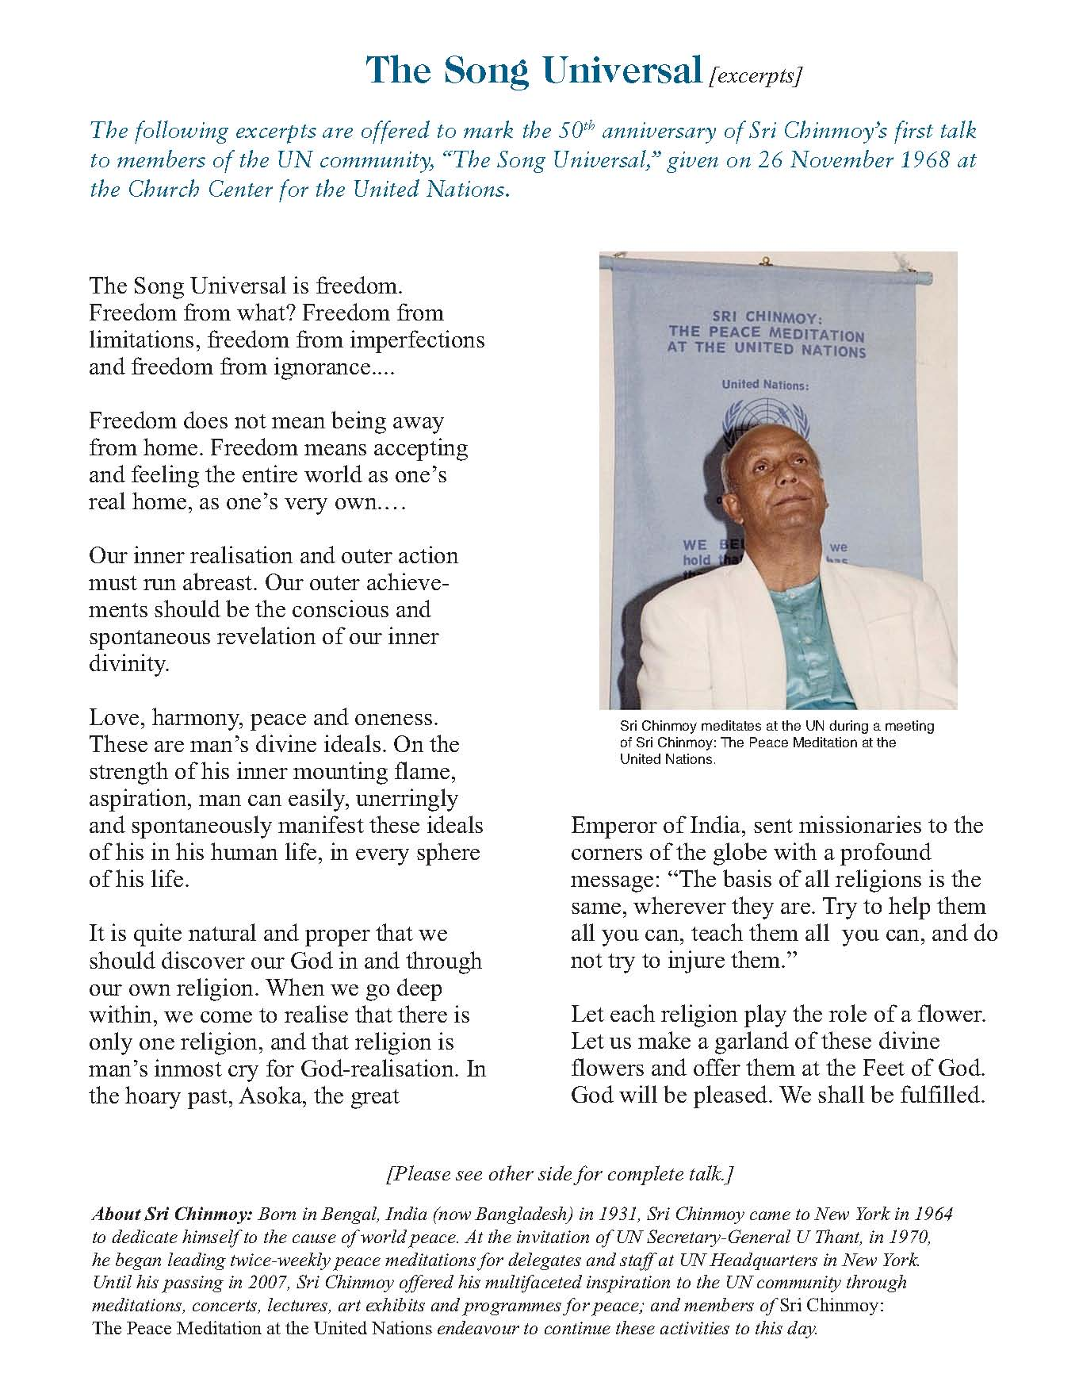
Sri Chinmoy’s First Talk to the UN community in 1968:
This first talk
(copy available)
is very significant
for several reasons.

Slide 7
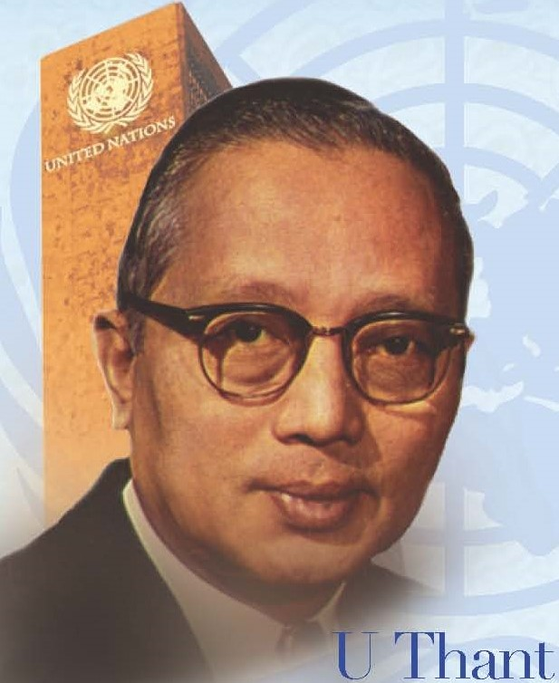
It was after this lecture on 26 November 1968 that Sri Chinmoy’s relationship with UN Secretary-General U Thant started blossoming

Slide 8
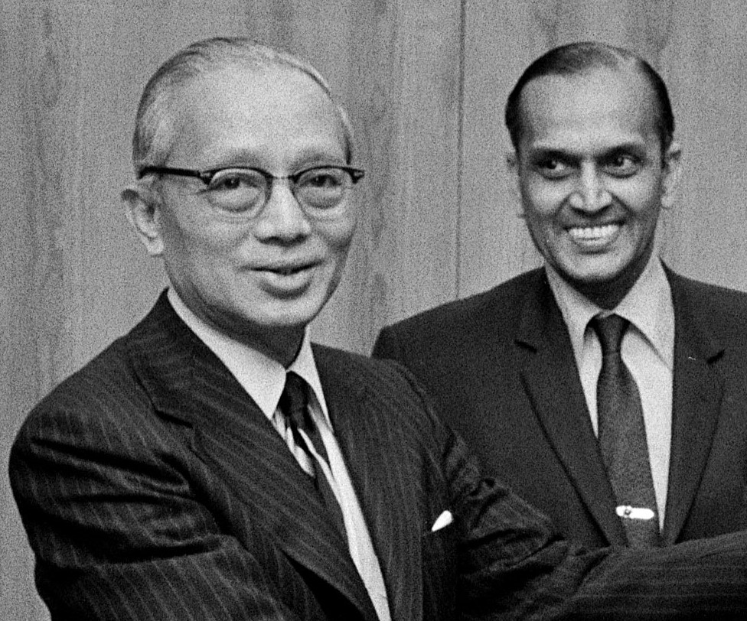
At U Thant’s request, his Chef de Cabinet C.V. Narasimhan Interviewed Sri Chinmoy and spoke very highly of him to the Secretary-General.
UN Photo Secretary-General U Thant and C.V. Narasimhan

Slide 9
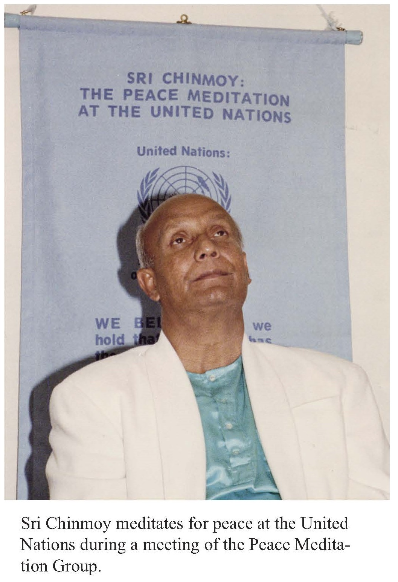
Narasimhan later conveyed messages between the two men, including U Thant’s encouraging invitation, for the establishment of the Peace Meditation Group at the UN on 14 April 1970.

Slide 10
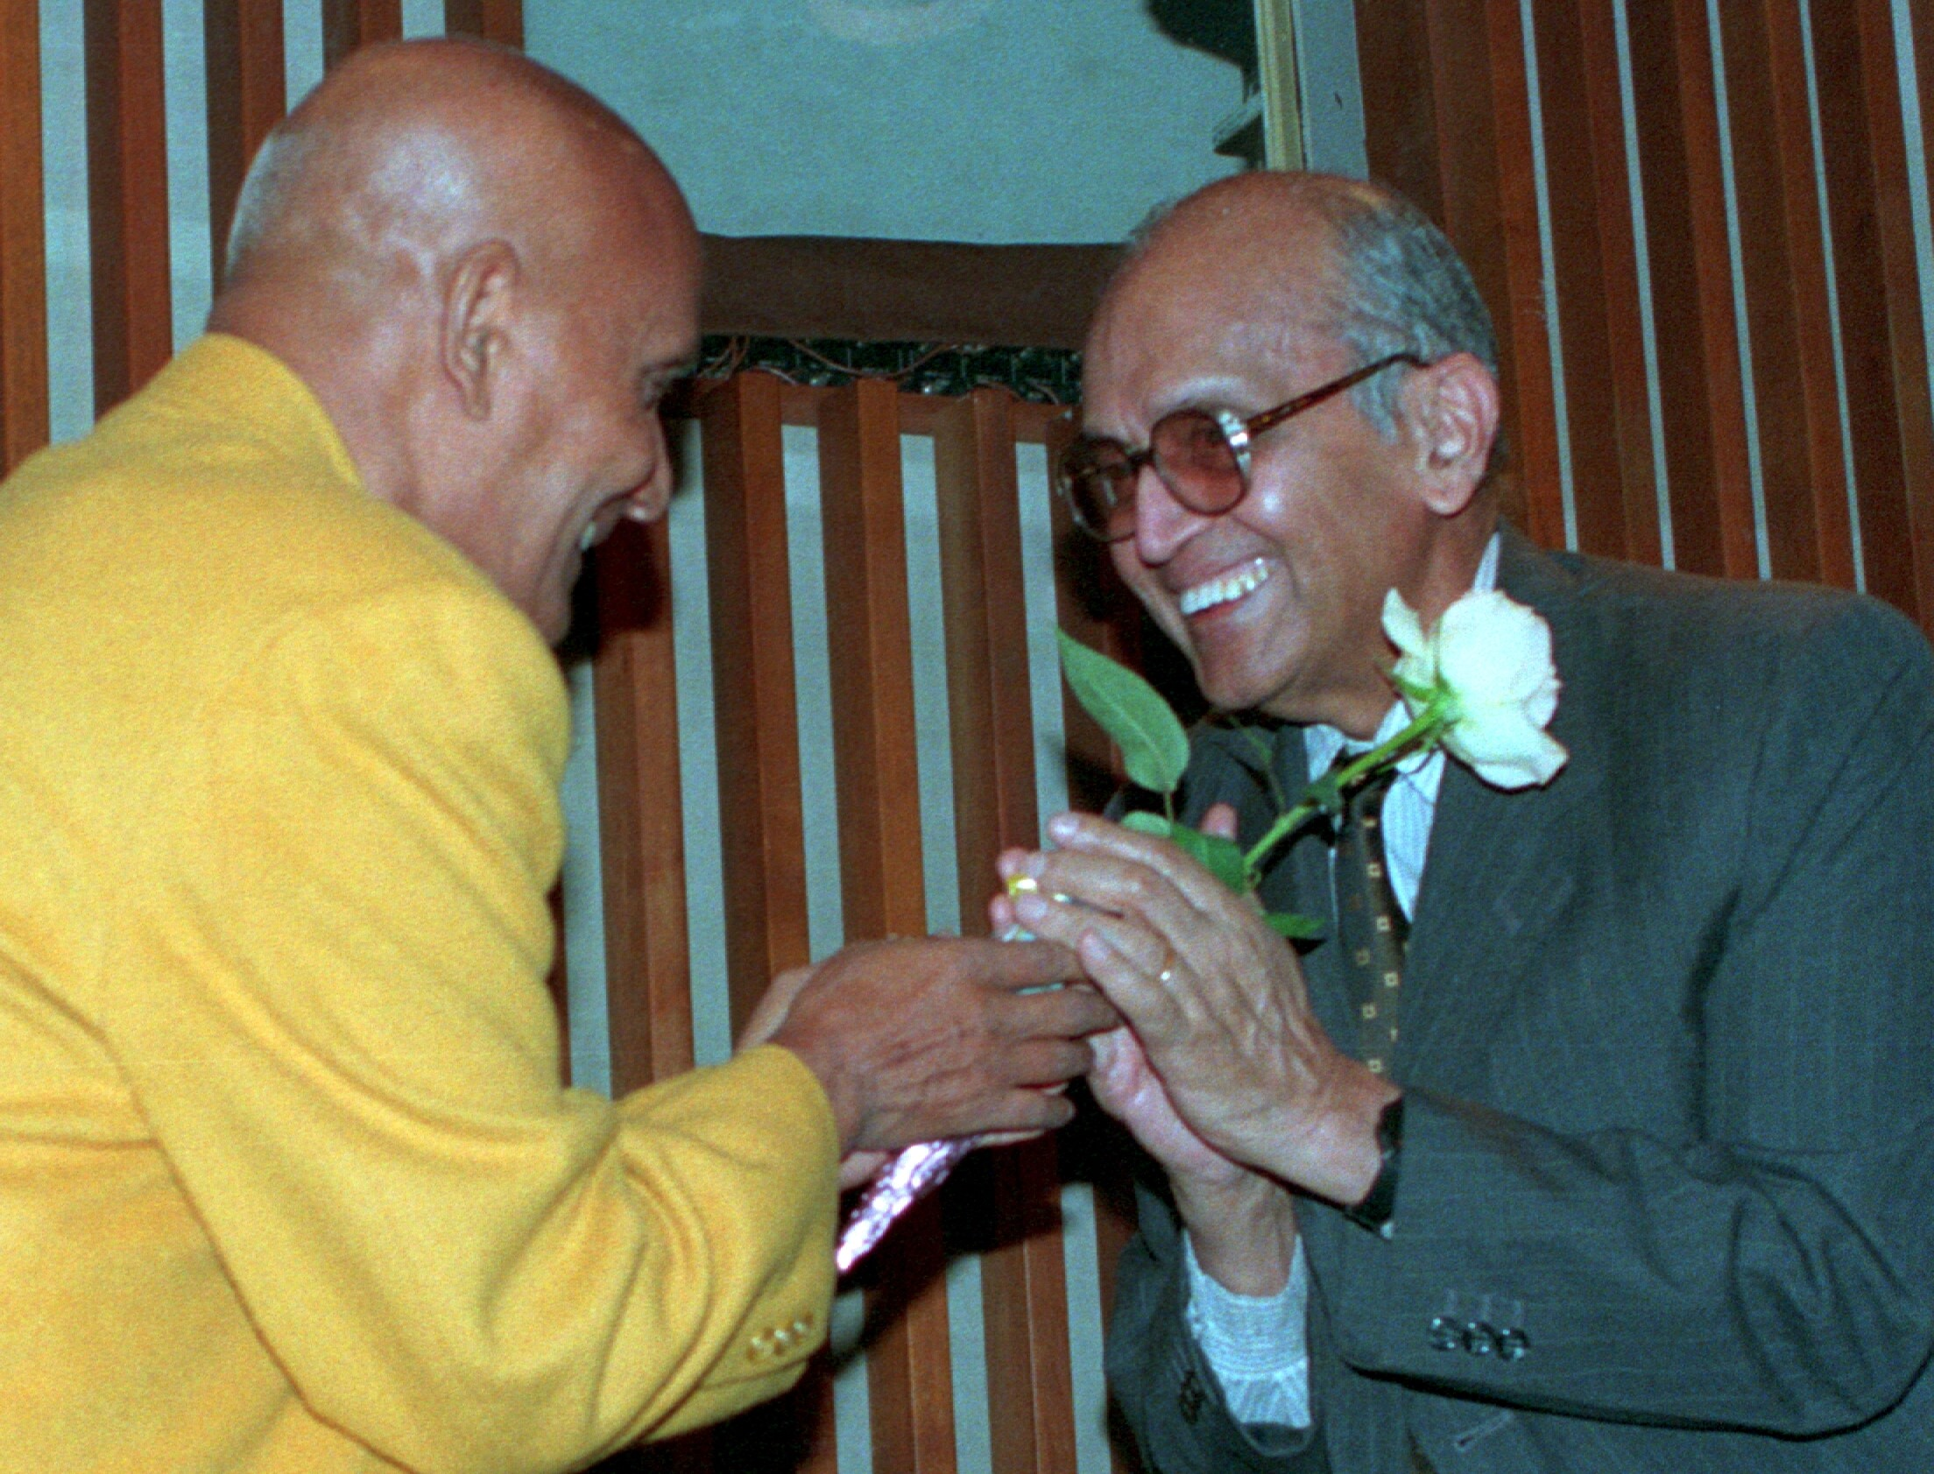
Many years later, C.V. Narasimhan was a special guest at Sri Chinmoy’s Peace Concert in the Dag Hammarskjold Auditorium on 6 Dec 1993 [coincidentally 25 years ago].
Sri Chinmoy and C.V. Narasimhan

Slide 11
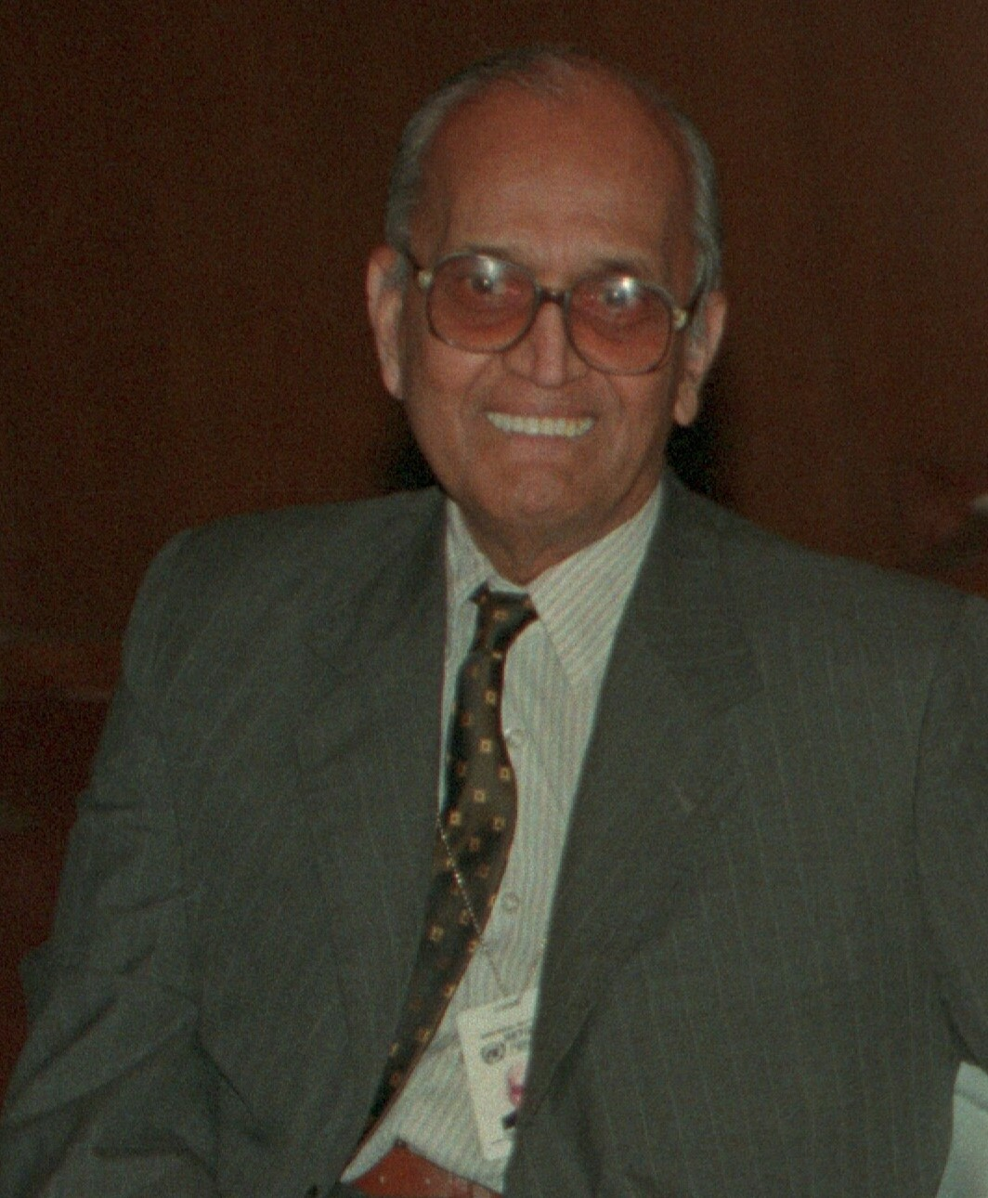
Under-Secretary-General Narasimhan was very proud of his role, remarking that “In the early days when U Thant was Secretary-General, I had a little role to play in having this Meditation Centre led by Sri Chinmoy in the United Nations as part of our ongoing activities.”
Under-Secretary General C.V. Narasimhan

Slide 12
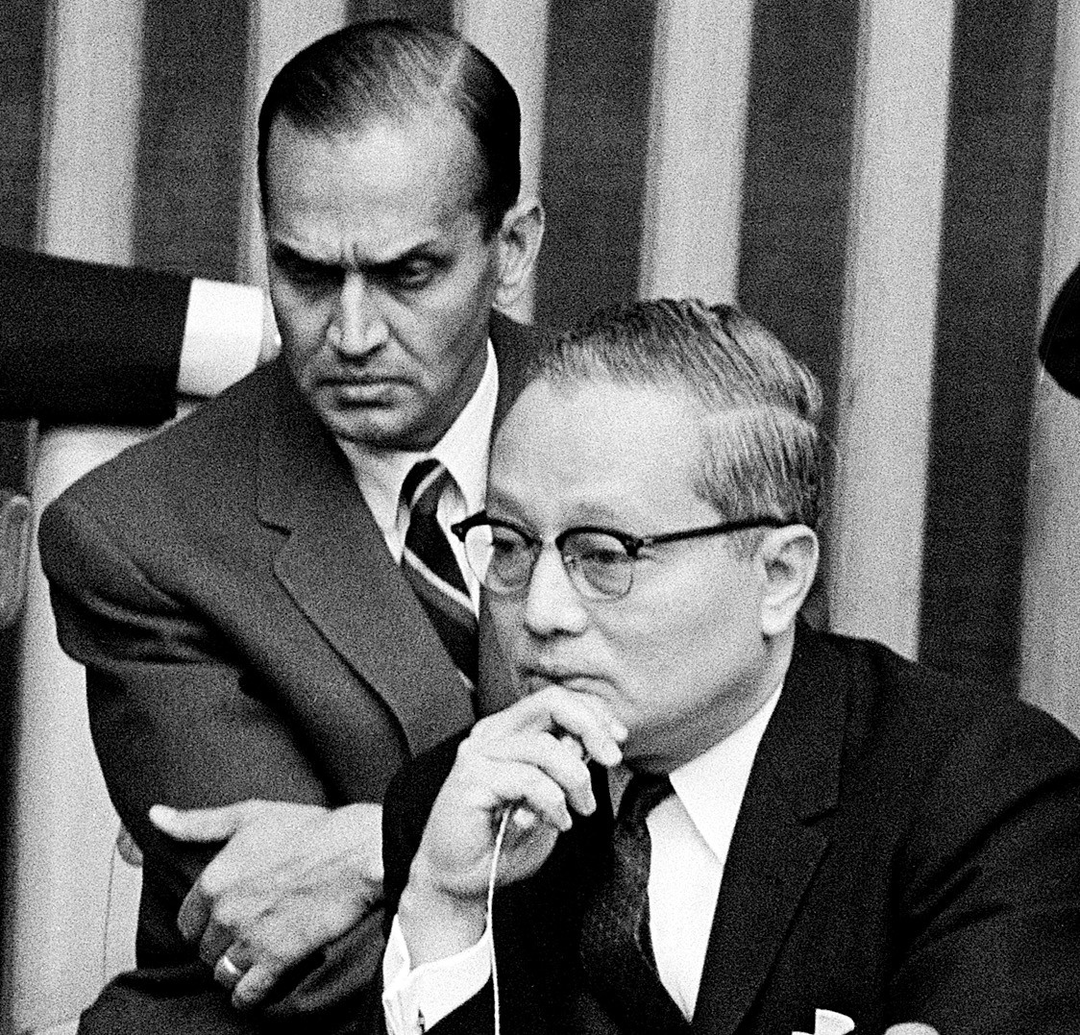
Sri Chinmoy called Narasimhan
“U Thant’s dearest colleague, his most valued friend, his confidant.”
UN Photo Secretary-General U Thant and C.V. Narasimhan

Slide 13
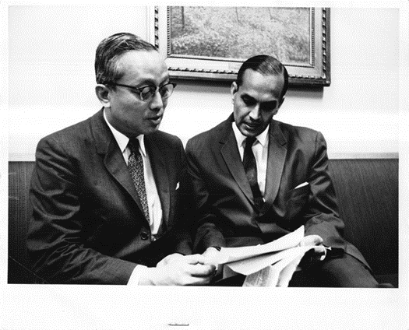
As a Buddhist and a Hindu, respectively, U Thant and Narasimhan both valued a spiritual approach to world affairs.
UN Photo Secretary-General U Thant and C.V. Narasimhan

Slide 14
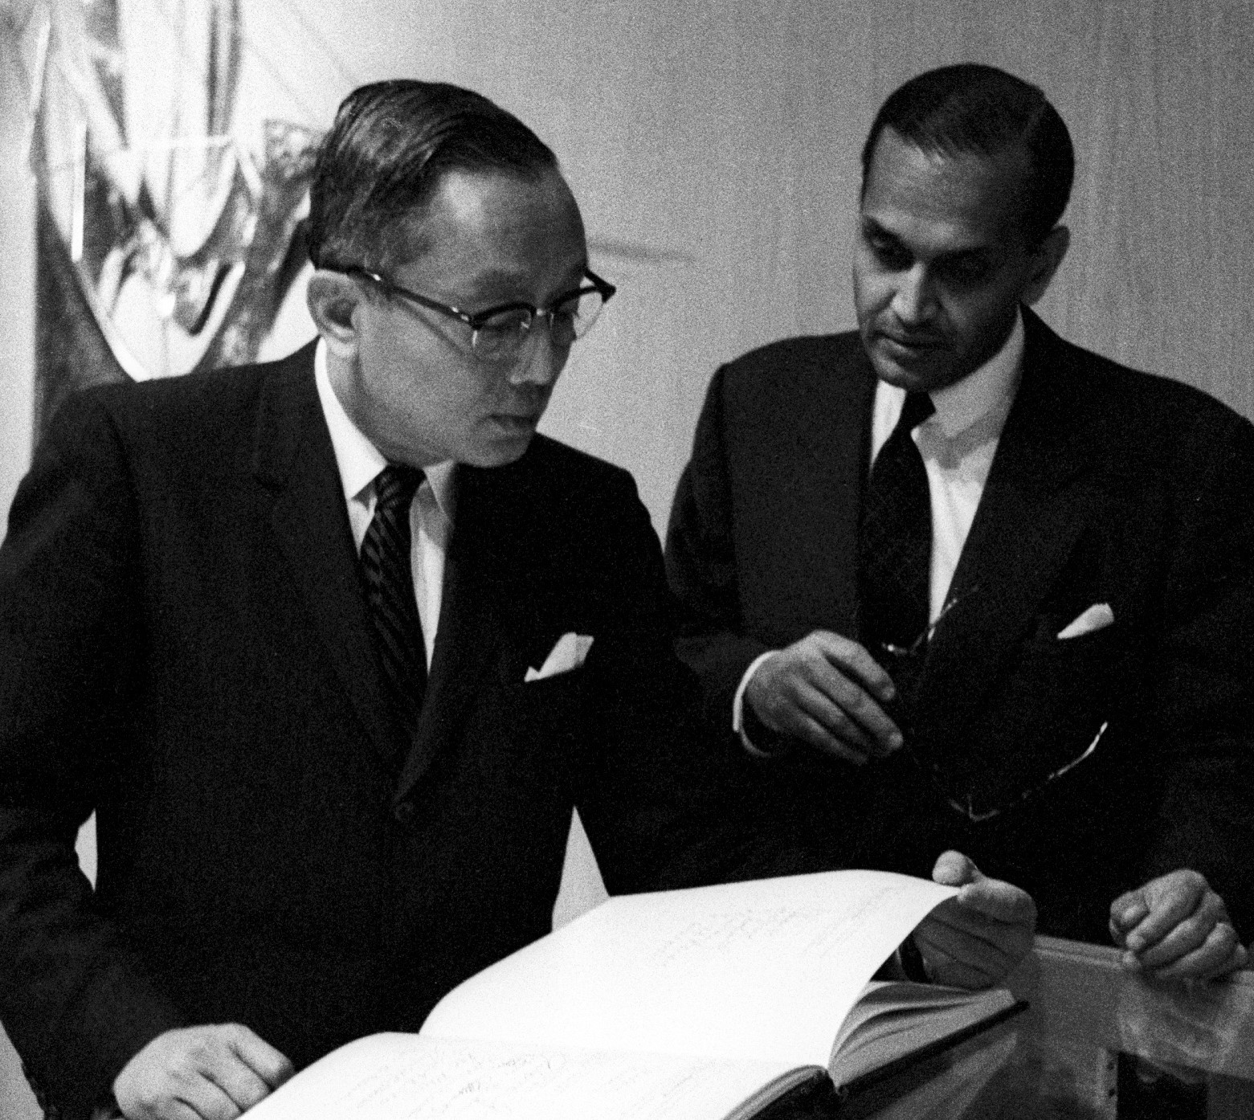
And it seems that from Sri Chinmoy’s first talk at the UN, together with subsequent interchanges, they both felt that Sri Chinmoy would further and support their own spiritual views and visions of the United Nations
UN Photo Secretary-General U Thant
and C.V. Narasimhan

Slide 15
which Sri Chinmoy poetically referred to as
the
“Heart-Home of the World Body.”

Slide 16
Now we will read out a few excerpts from the 1968 historic talk “The Song Universal.”

Slide 17
Freedom - Accepting World
The Song Universal is freedom. Freedom from what? Freedom from limitations, freedom from imperfections and freedom from ignorance....
Freedom does not mean being away from home. Freedom means accepting and feeling the entire world as one’s real home, as one’s very own.…

Slide 18
Realization – Action ; Achievement
Our inner realisation and outer action must run abreast.
Our outer achievements should be the conscious and spontaneous revelation of our inner divinity.

Slide 19
Ideals – Aspiration – Manifest
Love, harmony, peace and oneness. These are man’s divine ideals.
On the strength of his inner mounting flame, aspiration, man can easily, unerringly and spontaneously manifest these ideals of his in his human life, in every sphere of his life.

Slide 20
One religion – Inmost cry. Help, Teach All
It is quite natural and proper that we should discover our God in and through our own religion. When we go deep within, we come to realise that there is only one religion, and that religion is man’s inmost cry for God-realisation….
Asoka, the great Emperor of India, sent missionaries to the corners of the globe with a profound message: “The basis of all religions is the same, wherever they are. Try to help them all you can, teach them all you can, and do not try to injure them.”

Slide 21
Religion – Flower Garden – Fulfilled
Let each religion play the role of a flower.
Let us make a garland of these divine flowers and offer them at the Feet of God.
God will be pleased. We shall be fulfilled.

Slide 22
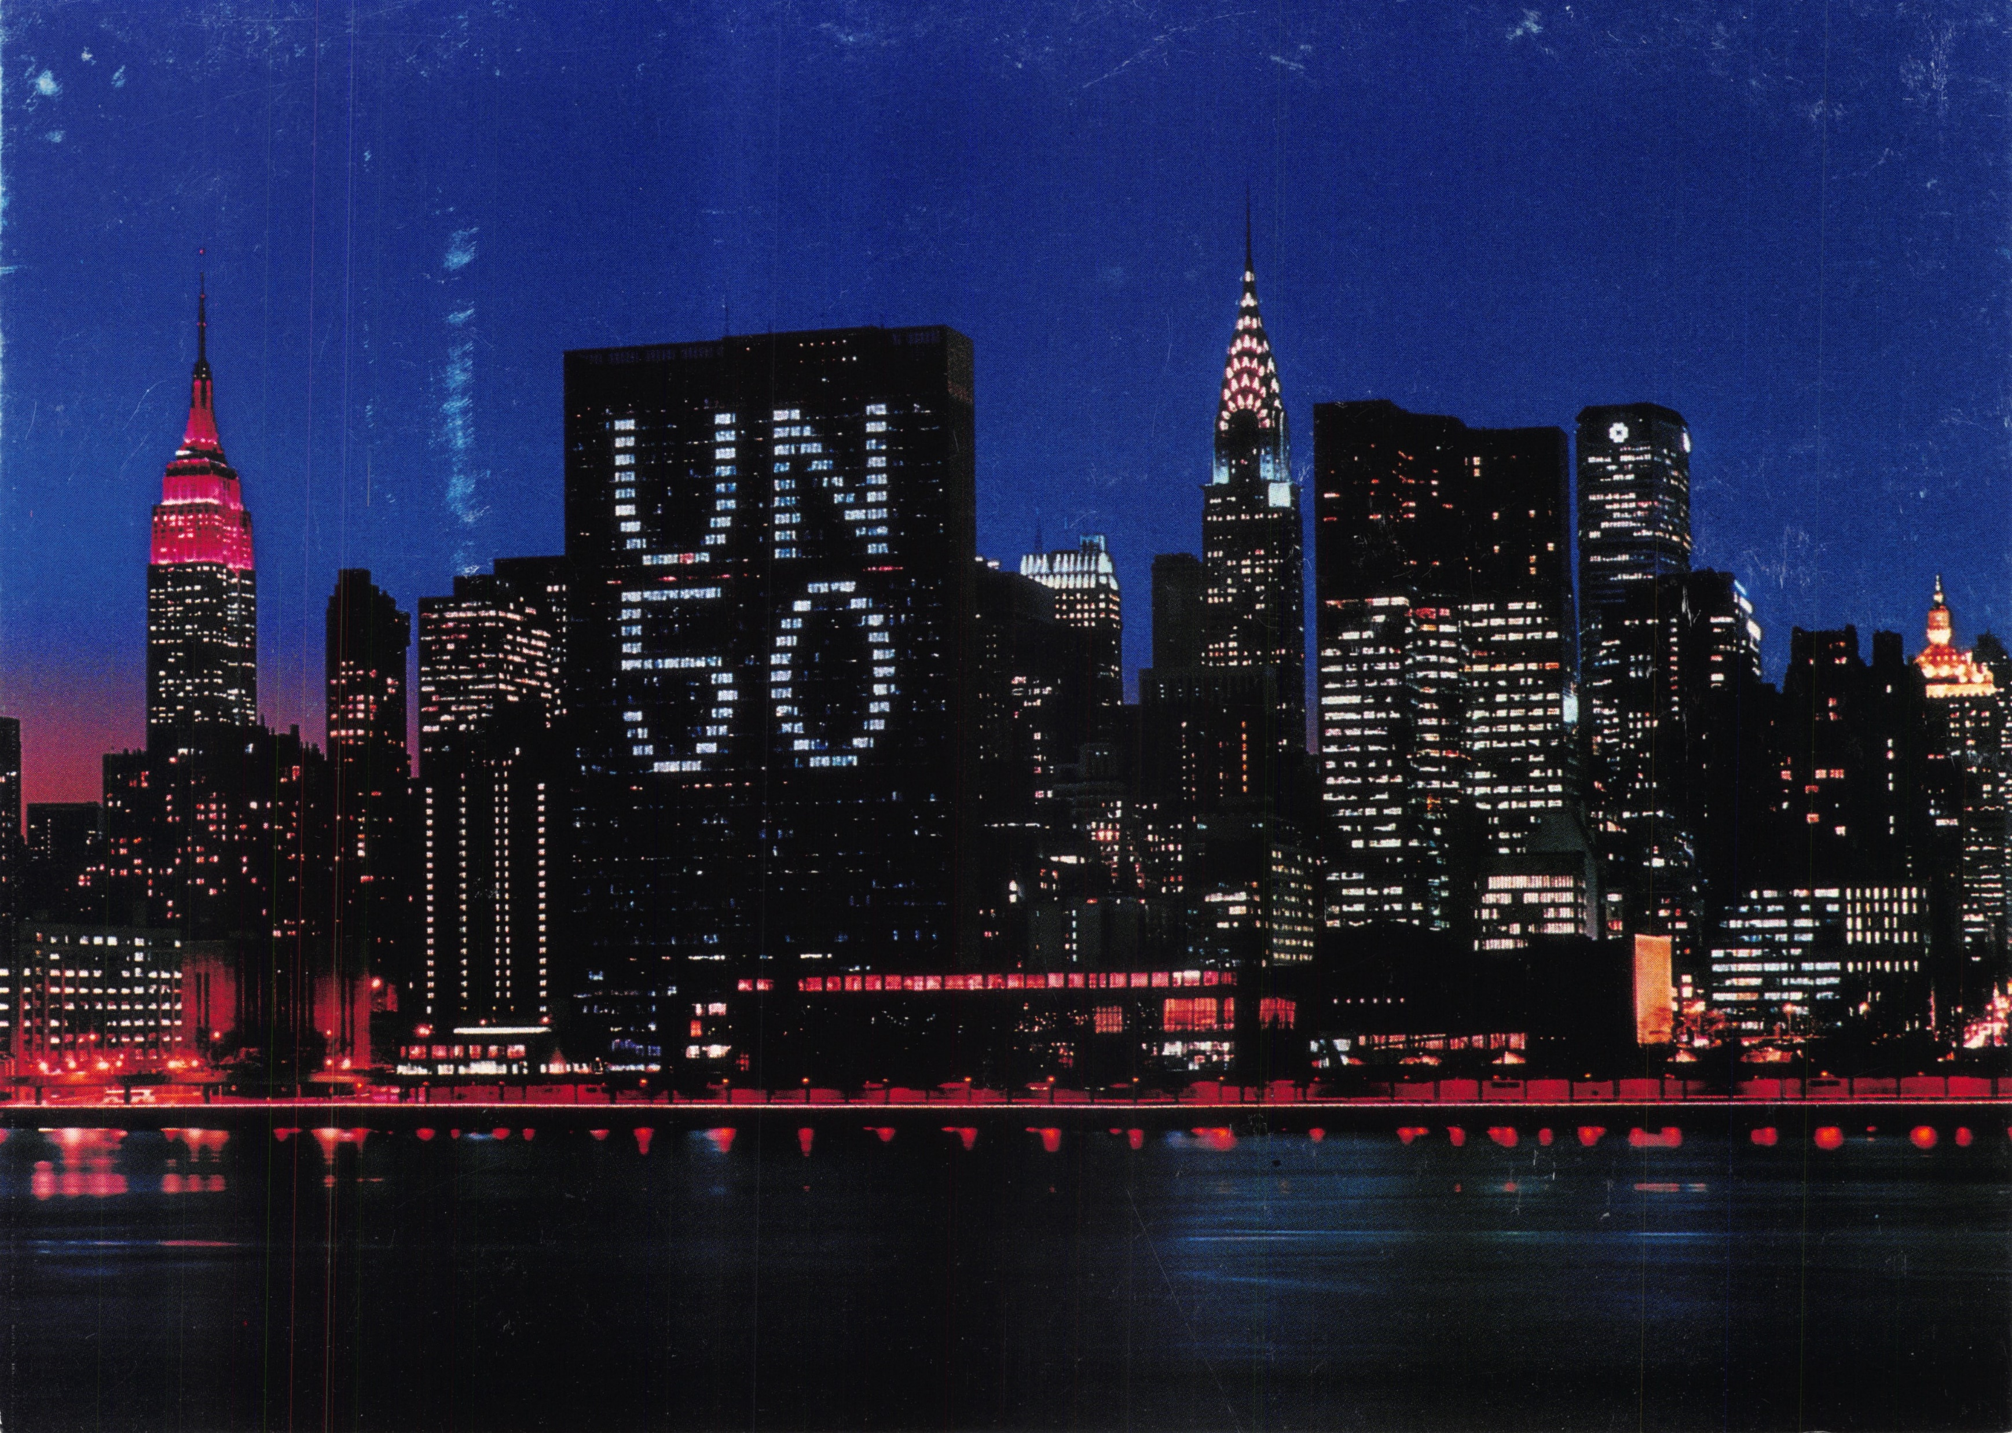
Introduction to Sri Chinmoy’s 50-Concert Tour offered to commemorate the 50th Anniversary of the UN in 1995
As mentioned earlier, December was also the anniversary of the final concert in the 50-Concert series that Sri Chinmoy offered to commemorate the 50th Anniversary of the UN in 1995.

Slide 23
That year also marked the 25th anniversary of the Peace Meditation Group at the UN.

Slide 24
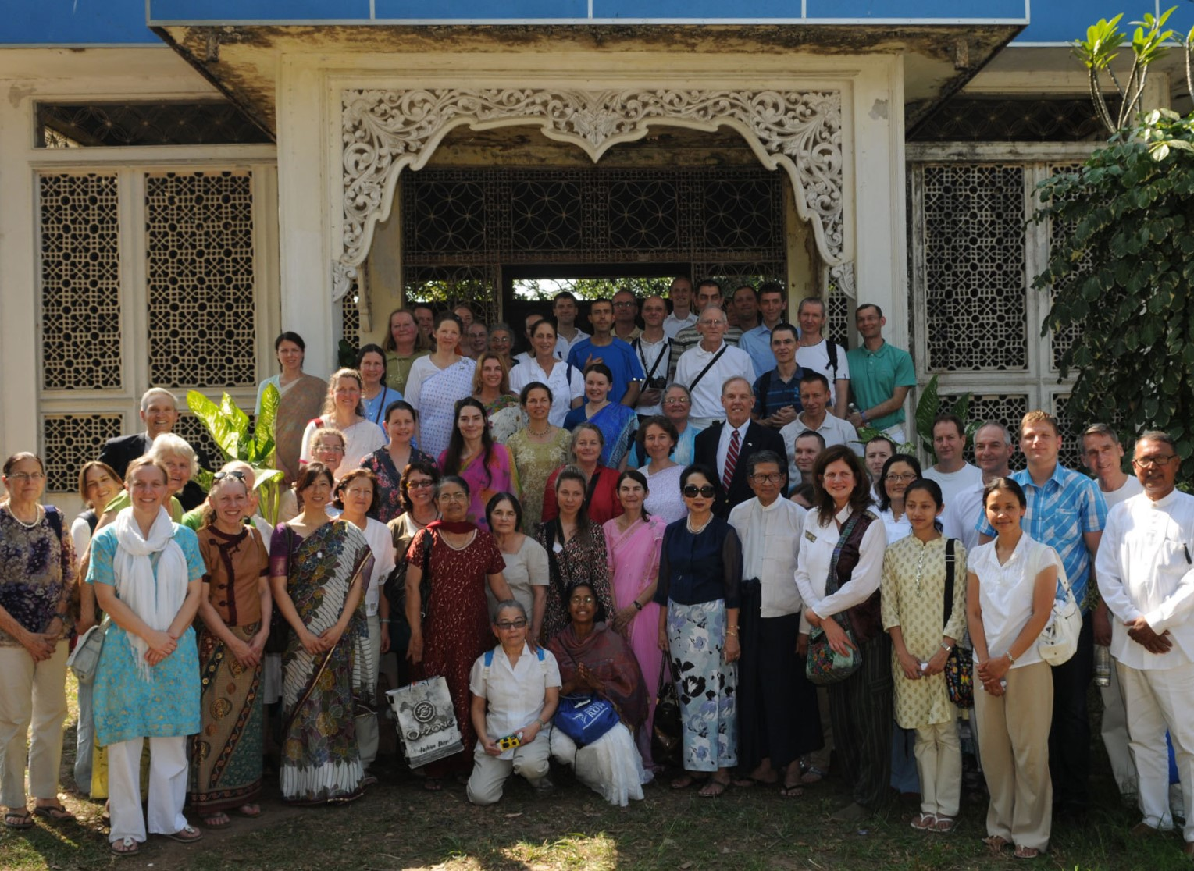
The first concert was held in Myanmar, birthplace of U Thant,
and
Members of Meditation Group joined with U Thant’s family and friends as part of 103rd Birth Anniv. Myanmar 21 Jan 2012 ,Yangon. Seen above in front of U Thant’s final resting place.

Slide 25
The last one in the elegant Penthouse of Lincoln Center in New York.

Slide 26
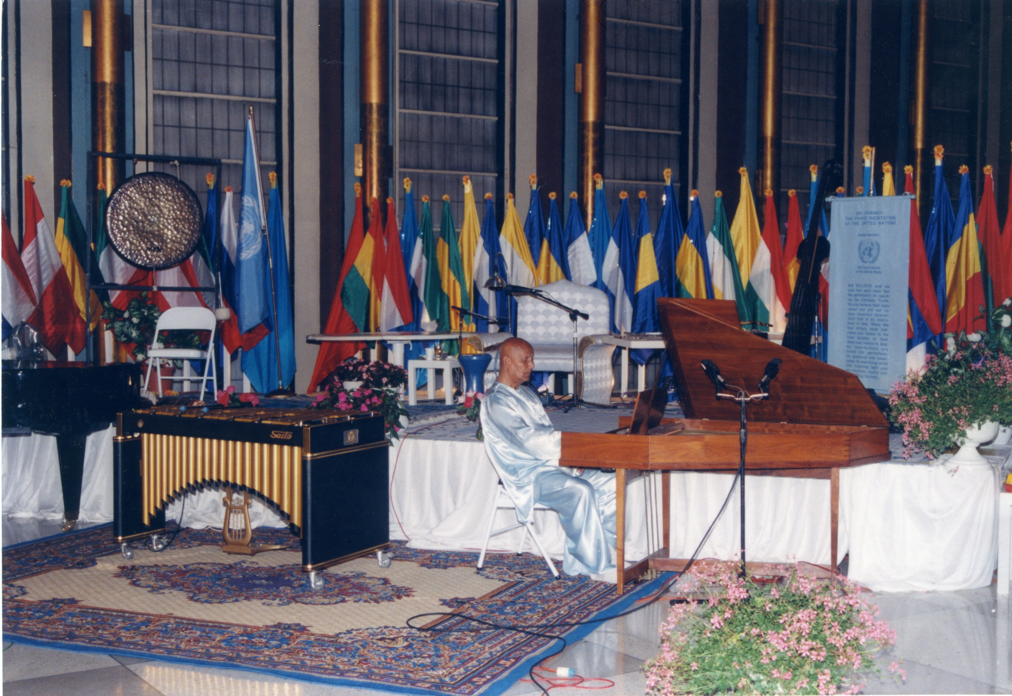
As part of the series, Sri Chinmoy also performed in many prestigious venues, including the UN General Assembly Hall Lobby,
with audiences as large as 10,000 in Washington, DC , 13,000 in Montreal and 15,000 in Prague.

Slide 27
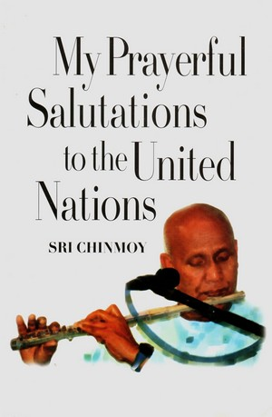
We will now share a few excerpts from Sri Chinmoy’s inspiring dedications and comments made at the Concerts.
Excerpts read by current UN workers and friends.

Slide 28
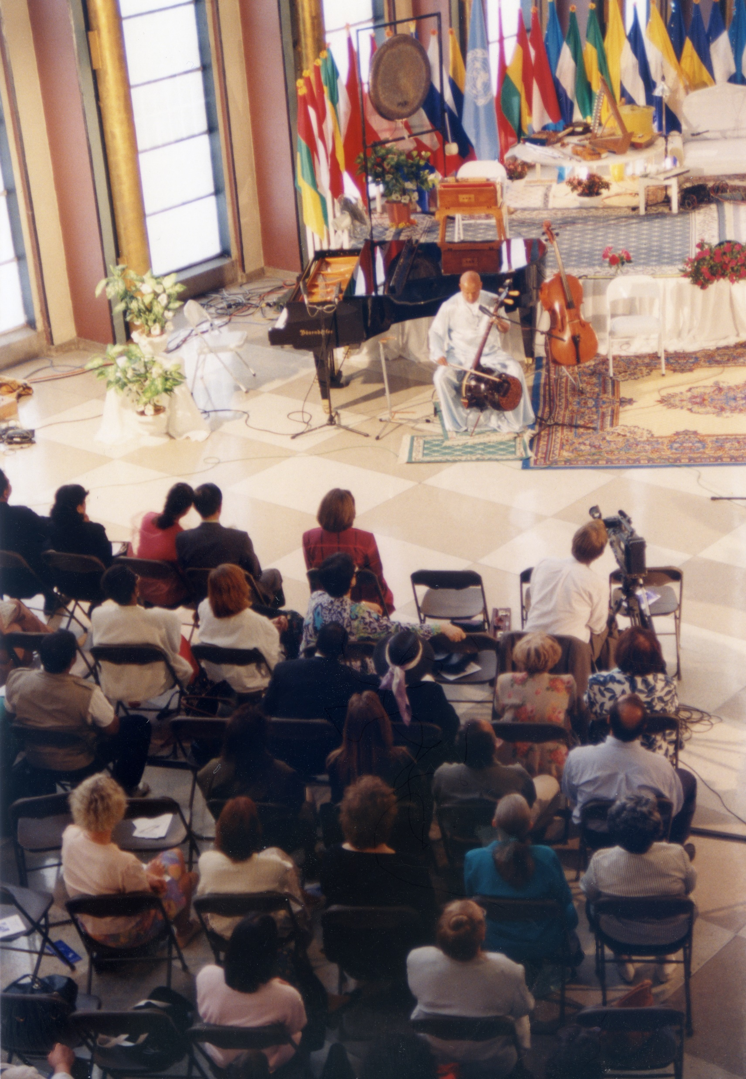
5 July 1995 O Supreme Pilot
of the United Nations,
do awaken the life,
illumine the mind
and bless the heart
of the United Nations.
Today’s Peace Concert I am offering
to the light-thirsty mind
and peace-hungry heart
of the United Nations.

Slide 29
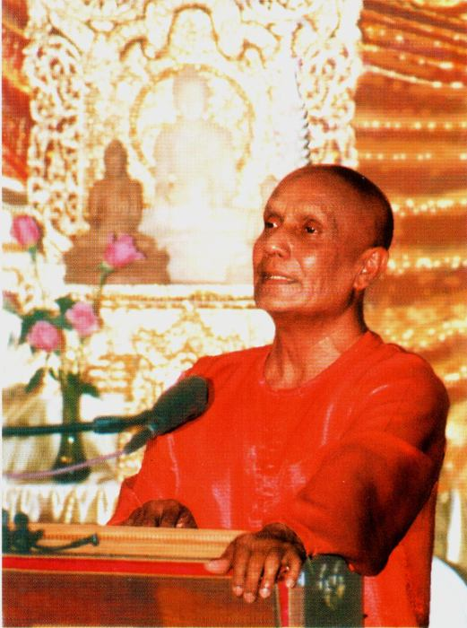
9 August 1995 As the human in us
wants greatness-heights and
the Divine in us wants
goodness-depths, even so,
the earthly mind of the United
Nations wants world-acceptance
and world-acclaim,
and the Heavenly heart of
the United Nations wants
self-sacrifice and world peace.

Slide 30
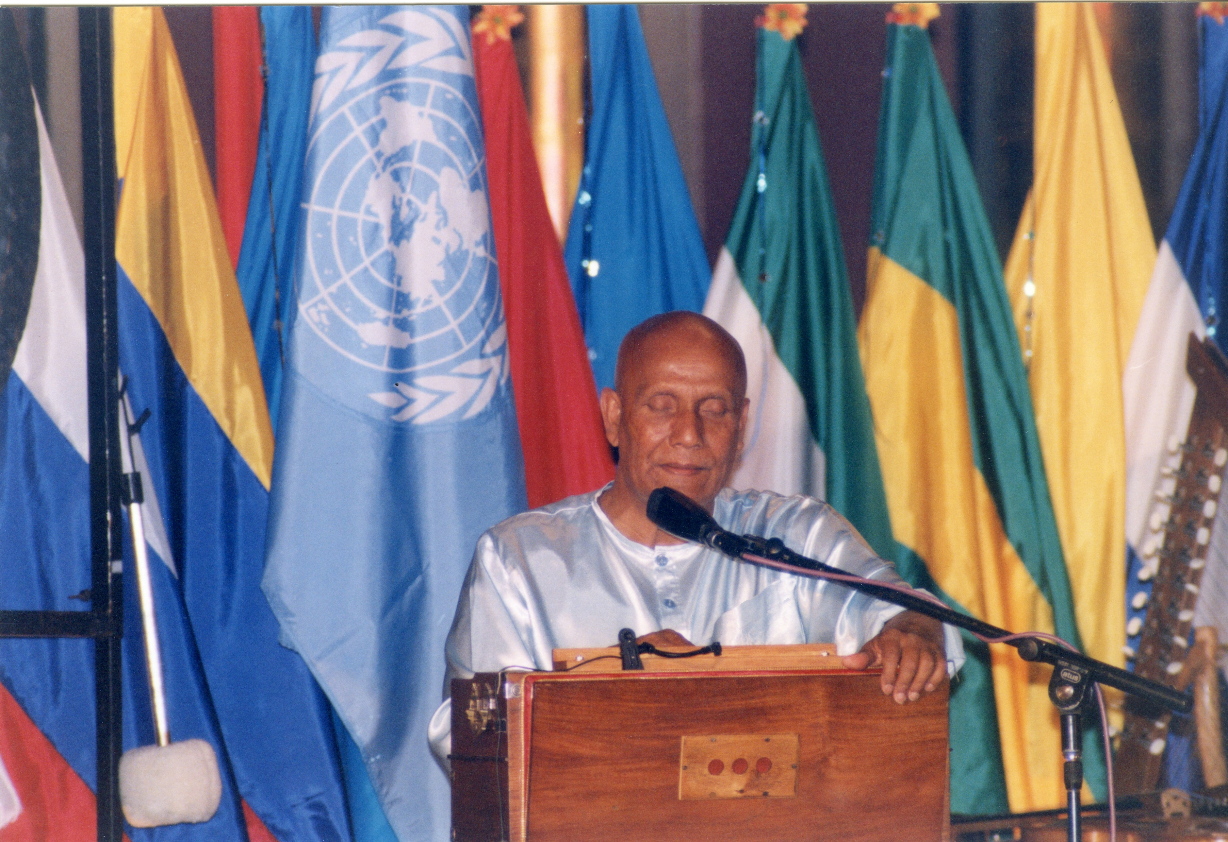
17 August 1995,
O United Nations,
the Absolute
Supreme
blessed you
With His most
precious Dream:
a world-oneness-
hunger.

Slide 31
19 August 1995 O soul of the United Nations,
do bring to the fore your indomitable will-power to
transform the earth-bound consciousness of humanity
into a Heaven-free consciousness.…
the Absolute Lord Supreme has entrusted you with
His Vision Supreme to change the face
and fate of mankind.
His own Promise in and through you
He will without fail fulfil at His own choice Hour

Slide 32
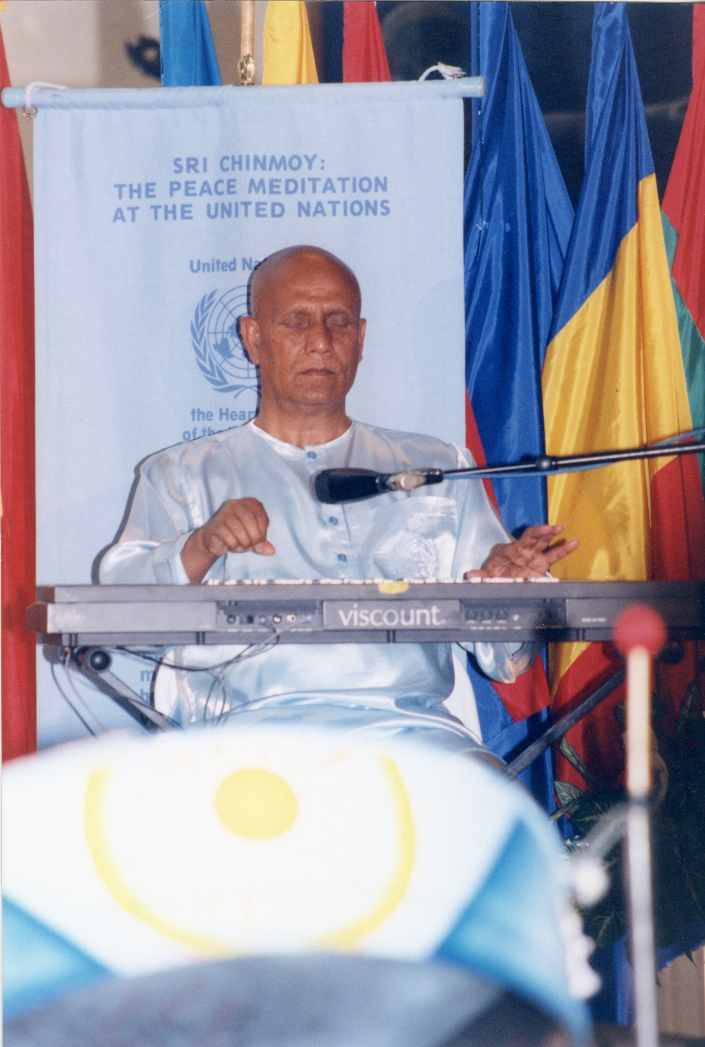
25 November 1995
One hundred fifty instruments
I shall play today.
I shall offer my gratitude
in one hundred and fifty ways
to the Supreme for creating
the United Nations,
which is the main instrument
to bring about world peace.
I am trying to be of service
to His main instrument, ….

Slide 33
We all have imperfections;
the United Nations also
has imperfections.
These imperfections must not ruin
our determination, eagerness
and enthusiasm.
Let us try to take these imperfections
as extra opportunities to make
ourselves absolutely perfect
by transforming them
into divine realities…..

Slide 34
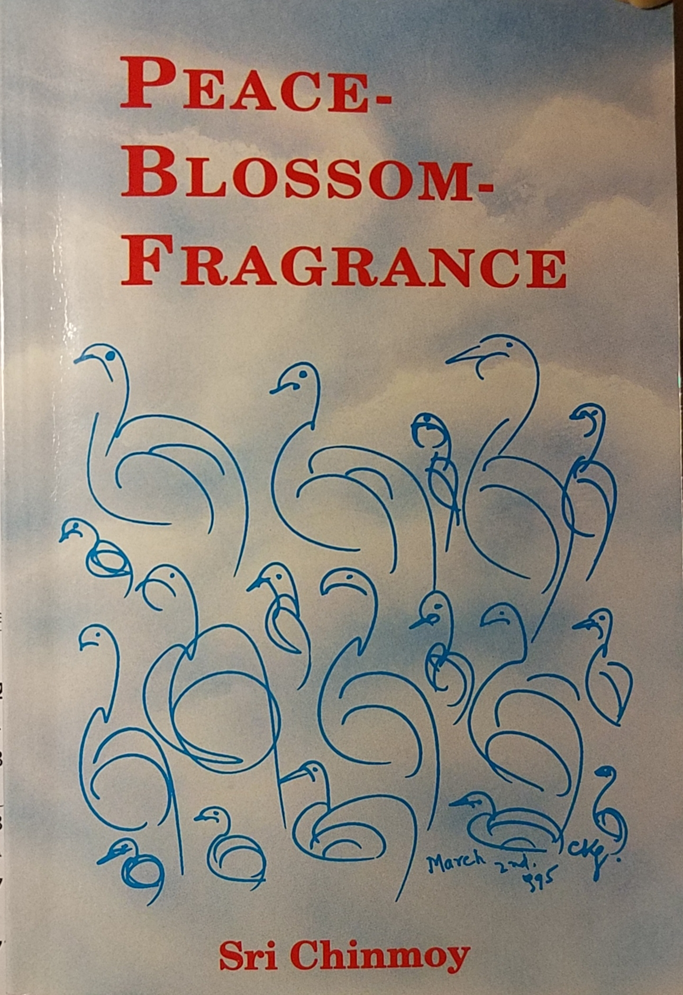
Introduction to 700 “Peace-Blossom-Fragrance” poems to honour UN’ 50th anniversary.
Between 11th and 12th November 1994 Sri Chinmoy composed 700 “Peace-Blossom-Fragrance” poems to honour the upcoming 50th anniversary of the United Nations.

Slide 35
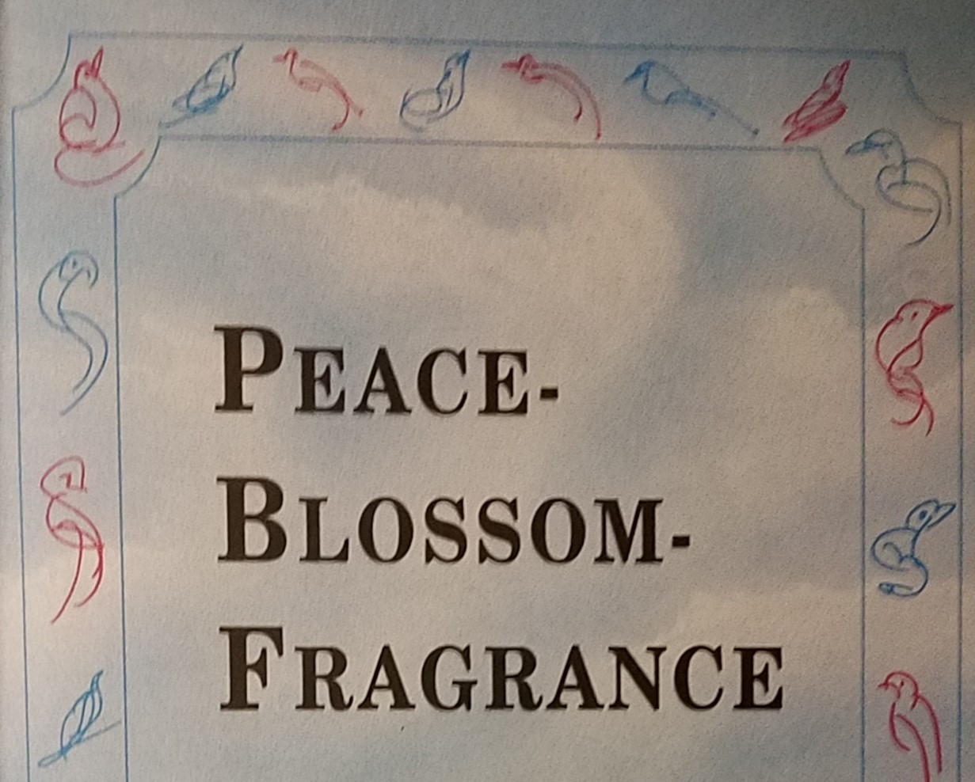
The page borders on the “Peace-Blossom-Fragrance” printed book were composed of birds selected from a series of “Dream-Freedom-Peace Birds” drawn by Sri Chinmoy beginning in 1992.

Slide 36
We hope the selections of Peace poems
presented
give a glimpse of the
variety, depth and
feeling for the
concept of peace
as experienced and shared by Sri Chinmoy
“Keep peace-dream Alive!”;
“Patience-preparation;
“Not retire, Aspire”;
“Peace of Here, Now”

Slide 37
Some short phrases
invoke an inner
commitment also
reflected in
Sri Chinmoy’s
Offering of
Peace Meditations
to the World Body
for decades.
“ Peace not comfort”;
“Find sterling Qualities,
“responsibility for peace”;
“accept imperfections
For transformation”

Slide 38
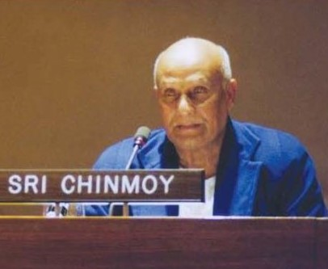
Through artistic and
poetic expressions
of Peace
he brought together
members of the
international community in silent dedication to
the ideal of a global
oneness-family.
At the Poetry Reading Celebrating the United Nations Year of the Dialogue Among Civilizations, held at the United Nations on 29 March 2001,
Sri Chinmoy is introduced by Master of Ceremonies Vijaya Claxton, Vice President of the United Nations SRC Society of Writers.

Slide 39
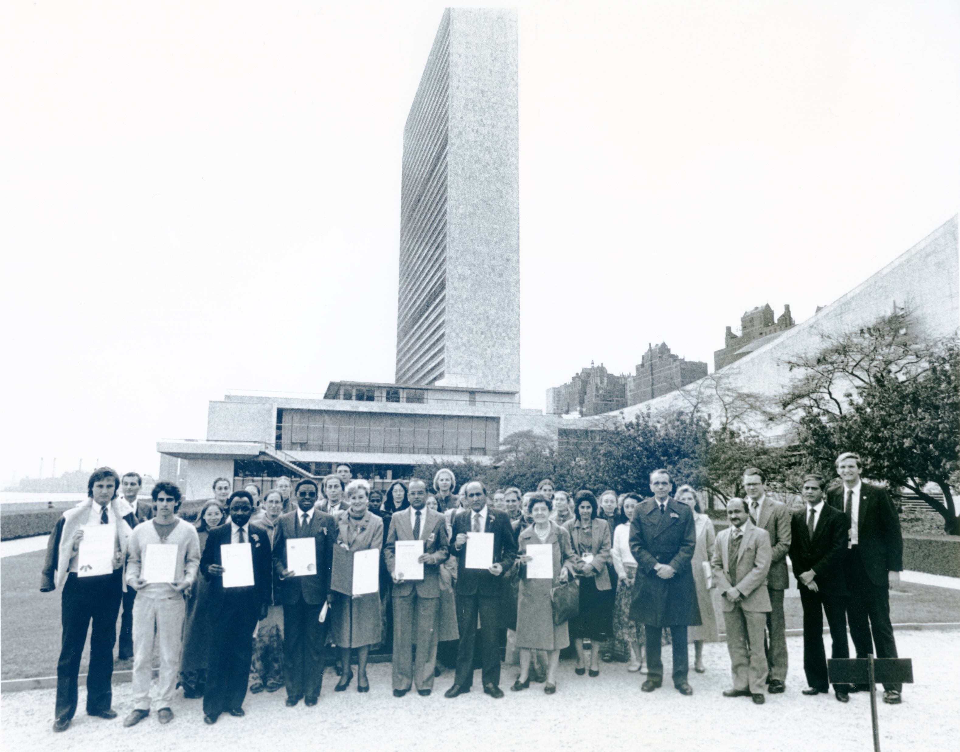
Goodness
Is
peace-drop.
3. Oneness
Is
peace-sea.

Slide 40
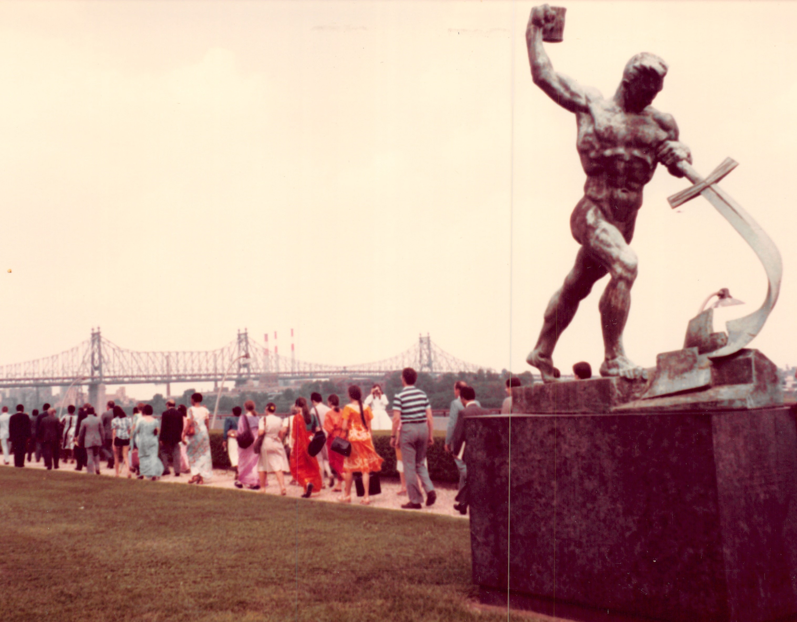
I enjoy peace
Only when I
am not afraid
Of changing
my
stubborn mind.
UN Garden, Peace walk for UN, 59th-st-bridge-in background - “Beat swords-to plowshares” -statue in front

Slide 41
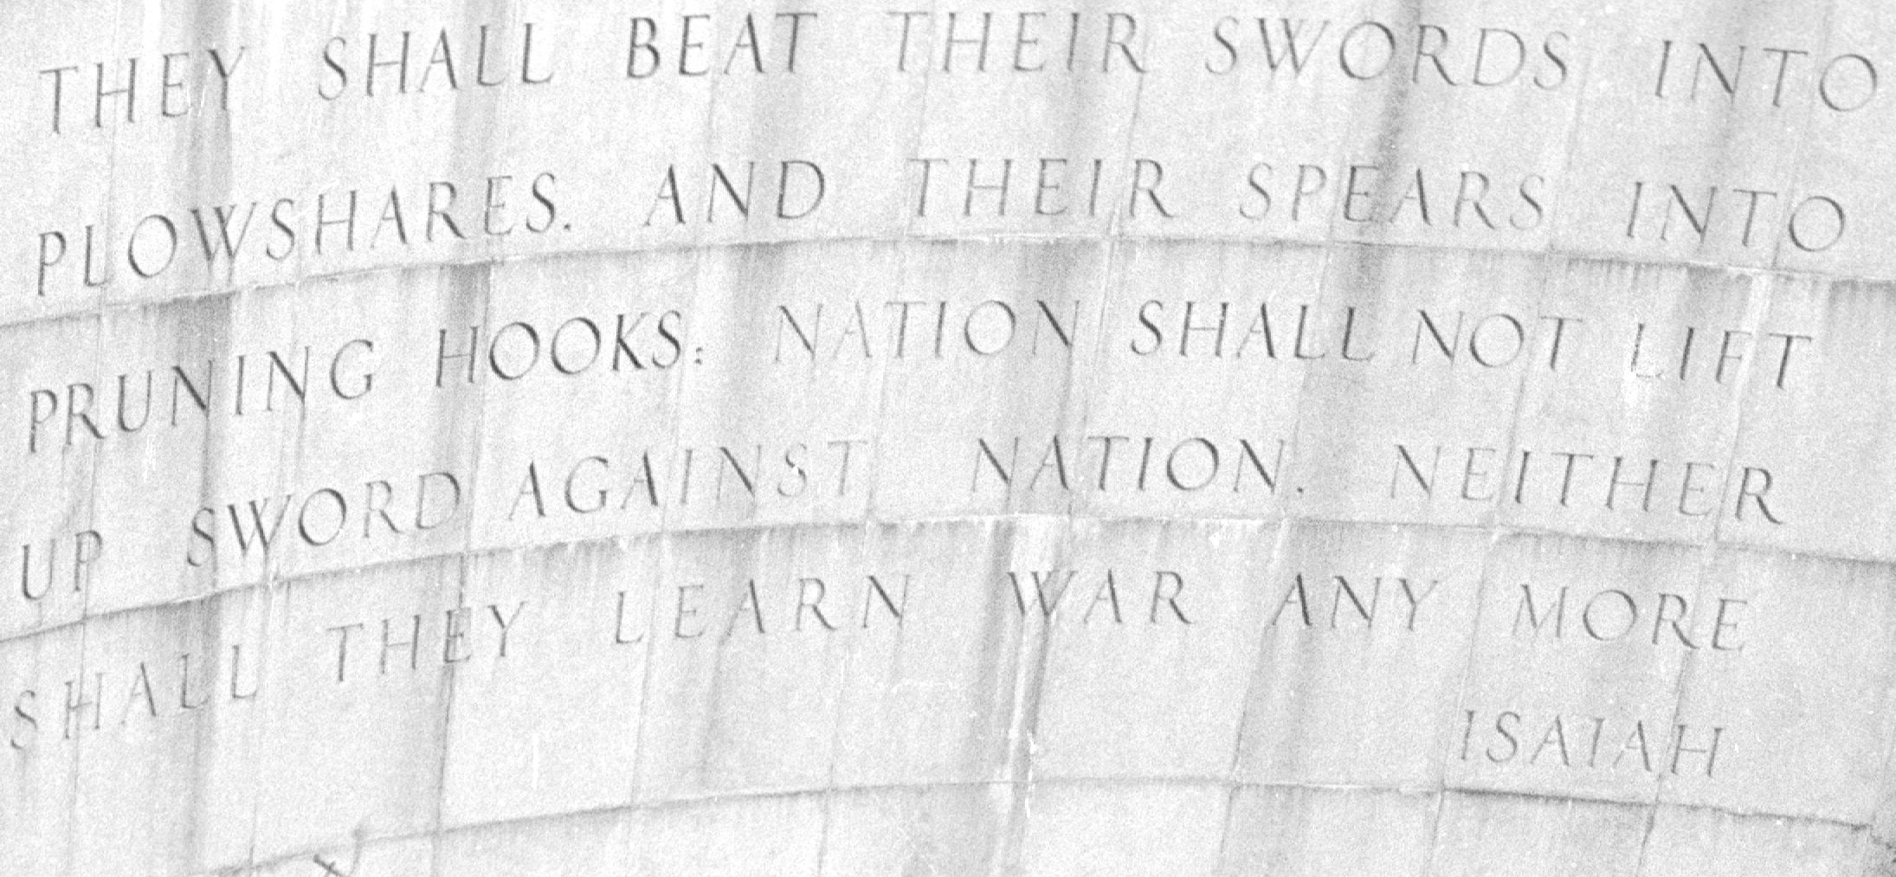
“Isiah wall” – across from UN Headquarters in NY
“They shall beat their swords into plowshares and their spears into pruning hooks.
Nation shall not lift up sword against nation.
Neither shall they learn war anymore.”

Slide 42
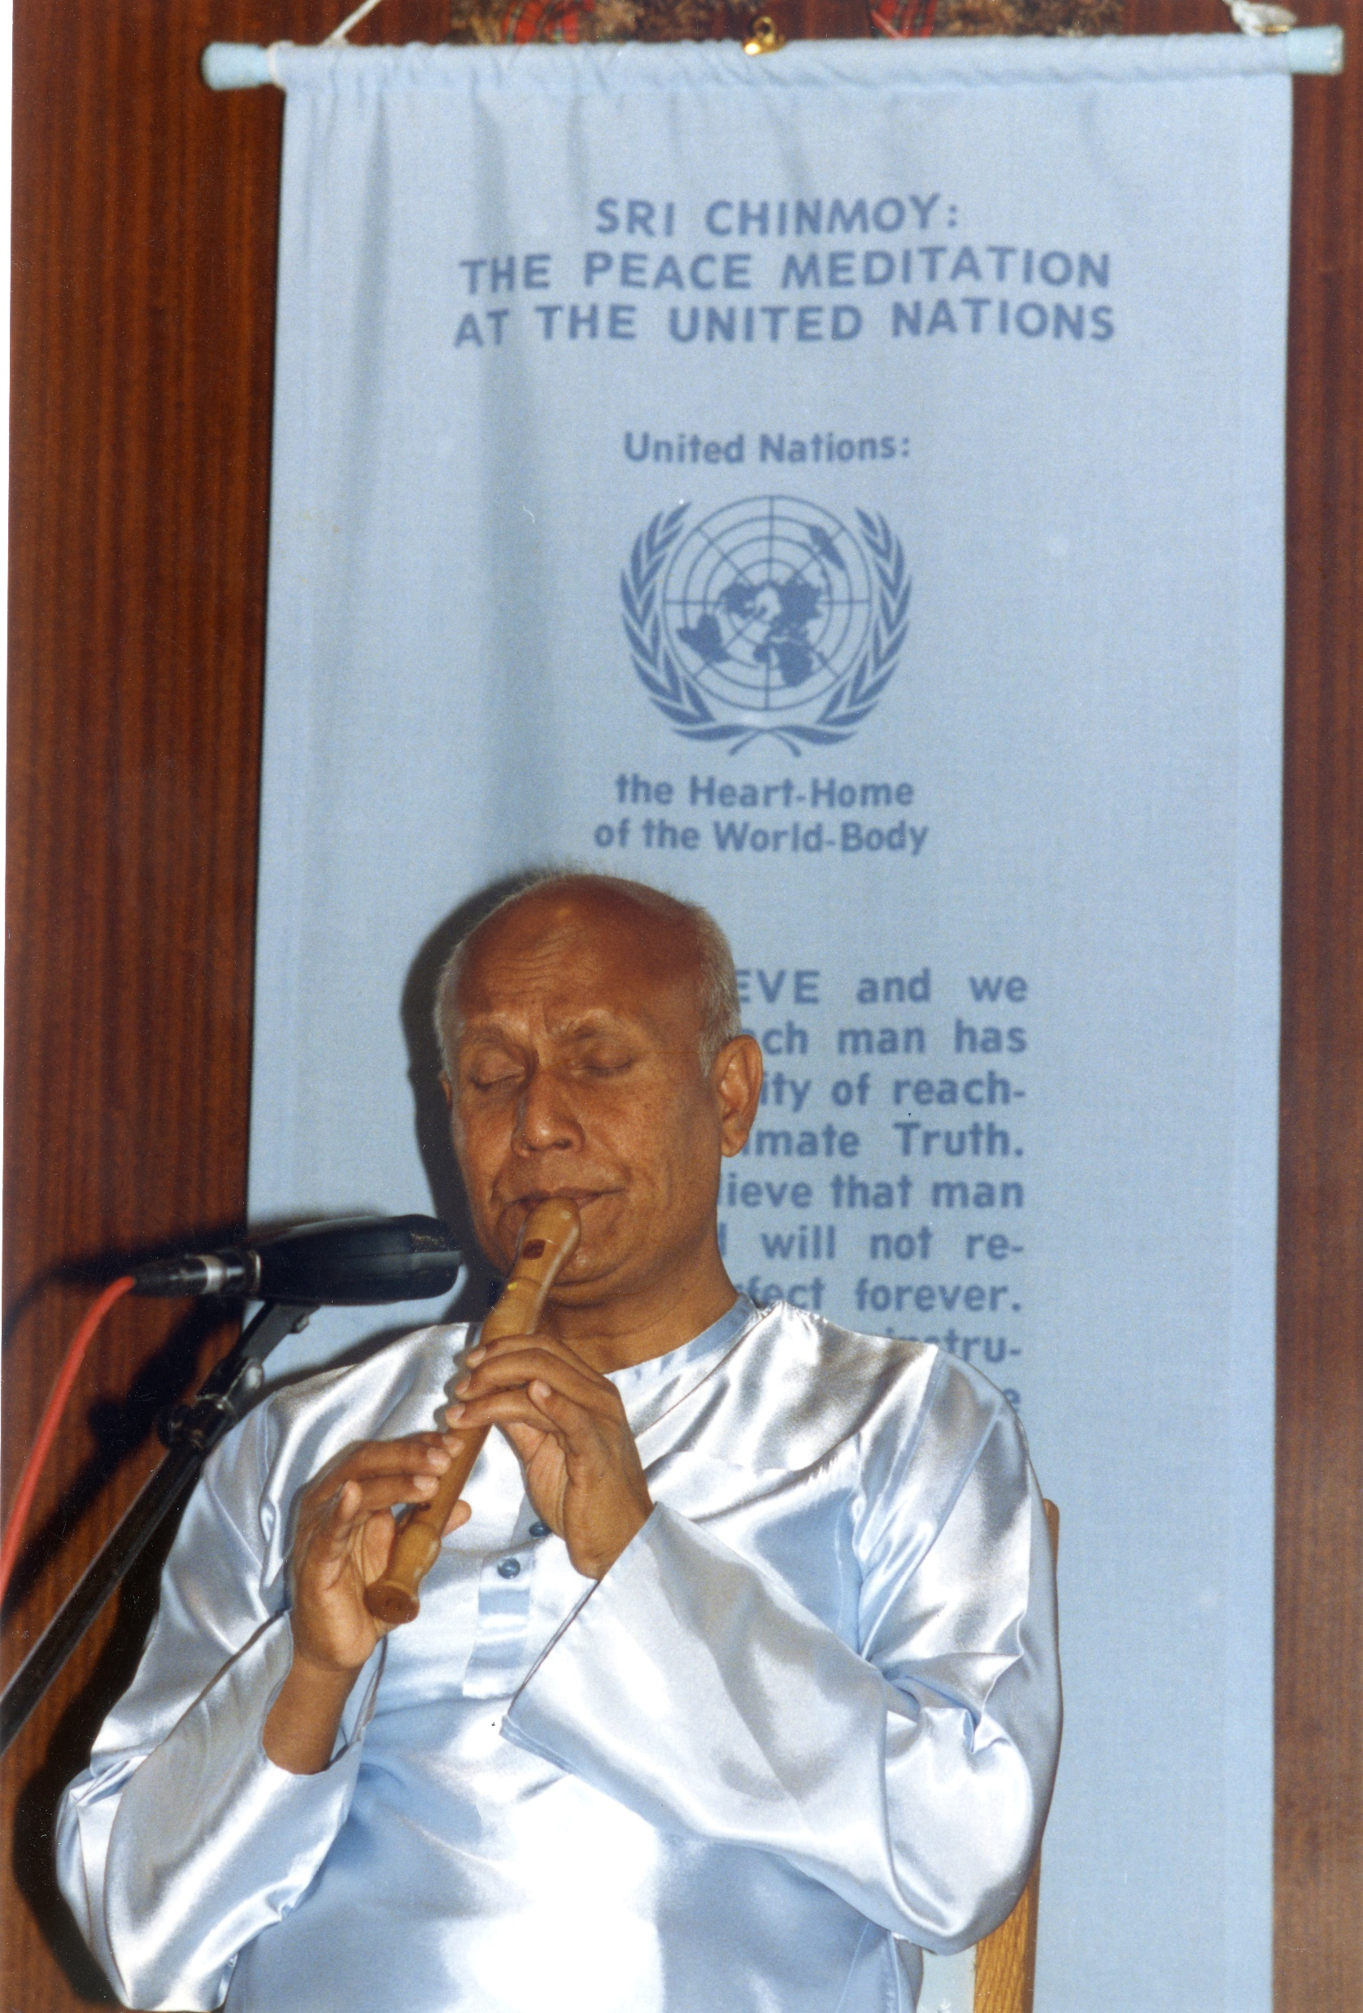
O truth-seeker
and God-lover,
You have only one task
to perform:
You have to keep
Humanity’s sacred
peace-dream
Alive.

Slide 43
humility
Exit →
Mind Gate
157. When humility exits
From the mind-gate,
Peace is compelled to exit
From the heart-gate.
Peace
MUST Exit →
Heart Gate

Slide 44
Love ( - ) Peace
( = )
Love without
peace
Is a joint Dance
Of stupidity
and absurdity.
Stupidity ( + ) Absurdity
Dance

Slide 45
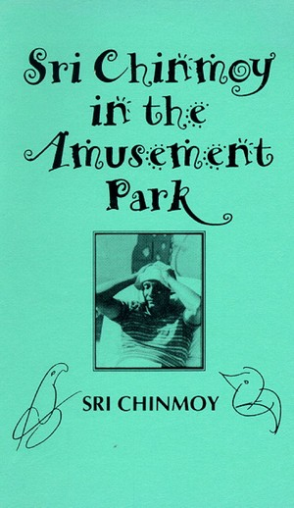
Peace I get
When my mind
Laughs at me
Powerfully.

Slide 46
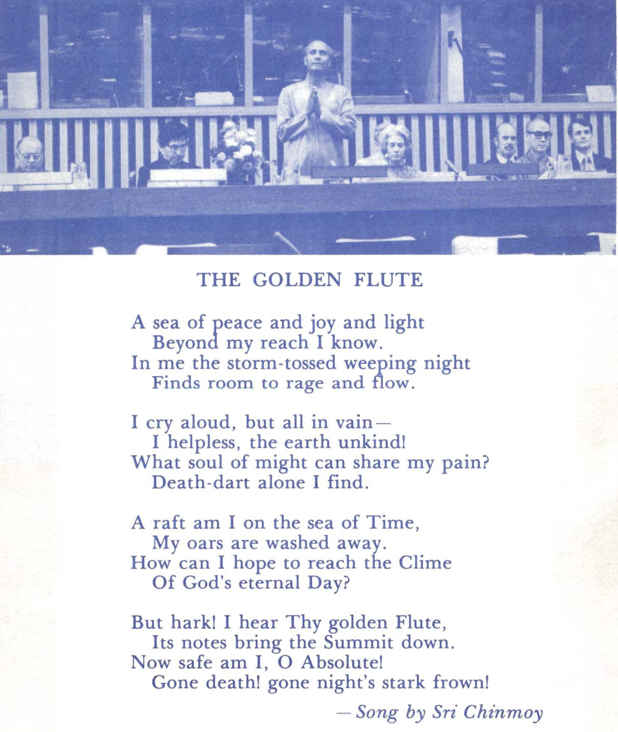
208. To feel peace,
I shall not climb up to
The mountaintop.
I shall not sit at the foot
Of the mountain.
I shall just enter into
My heart-nest.

Slide 47
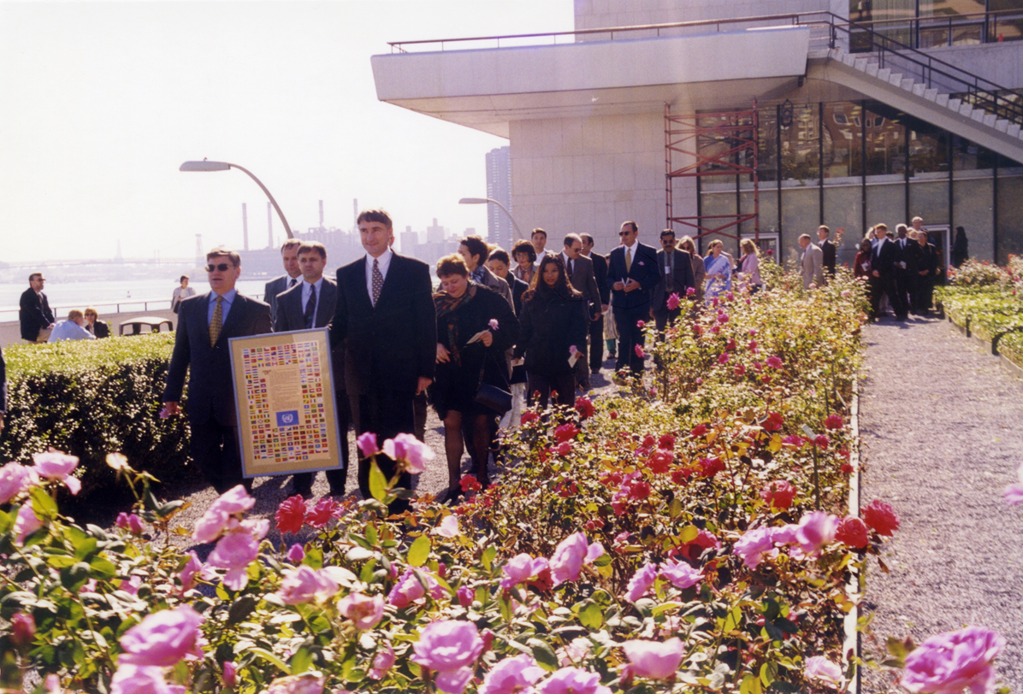
Peace
Becomes a reality
Only after endless Patience-preparation.
United Nations delegates and staff carry a ceremonial copy of UN Charter
during a Peace Walk in the UN Garden ,
coordinated by the Peace Mediation at the UN.

Slide 48
Peace I feel not
When I long to retire
From the world.
Peace I feel
When I long to aspire
For the world.

Slide 49
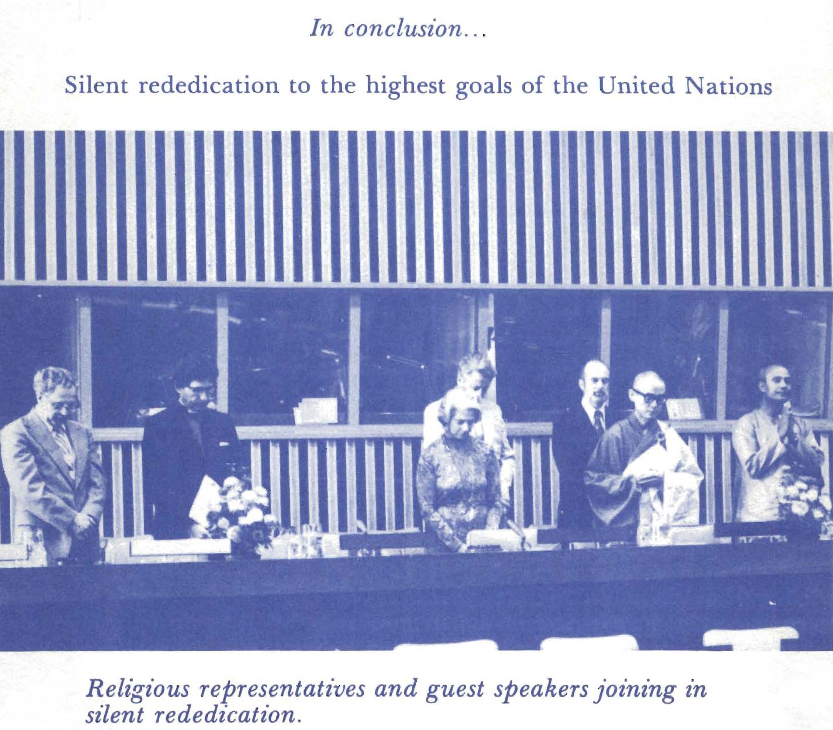
I do not need the peace Of the stars and planets
Of the ages.
I need the peace
Of the flowing and glowing
Here and now.

Slide 50
Be sure
That what you want is Peace
And not comfort.
Spend considerable time
In finding sterling qualities In others,
Rather than in finding Their blazing faults.
Your mind will be full Of peace-blossoms.

Slide 51
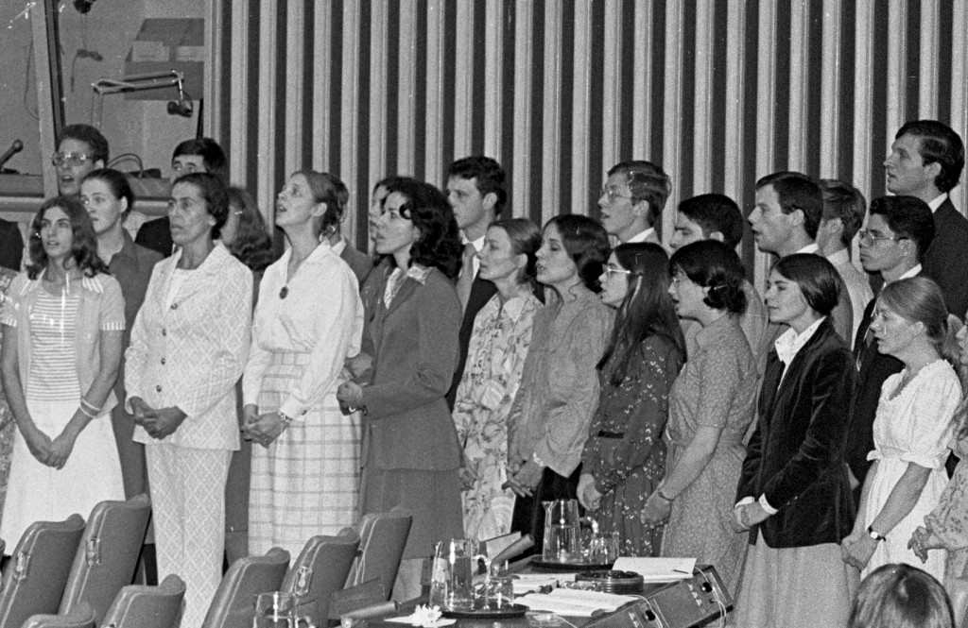
If we do not have the feeling of
Collective responsibility
for peace,
Then peace will never be
a reality,
Either in the heart of today
Or in the life of tomorrow.
Peace Mediation at the UN group members performing
at programme Commemoration Opening of 30th Session UN General Assembly

Slide 52
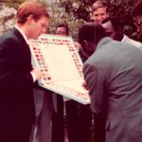
What an absurd idea:
The mind wants to achieve peace
By denouncing
The world’s imperfections.
What a fruitful ideal:
The heart wants to achieve peace
By accepting
The world's imperfections
For their total transformation.
UN Delegates carrying and signing copy of UN Charter during Peace walk in UN Garden.

Slide 53
“To the end I will love the United Nations “ part 1
Whoever leads the United Nations should
use only the heart,.
The world will feel that the UN has a sincere heart.
That sincere heart will be able to gain
the confidence of the world.
Now, because of unfortunate things
that are taking place in various countries,
the world does not have the same feeling,
the same sympathetic heart.
13 March 2005, Sri Chinmoy, His Compassion is everything to us, Agni Press, 2013

Slide 54
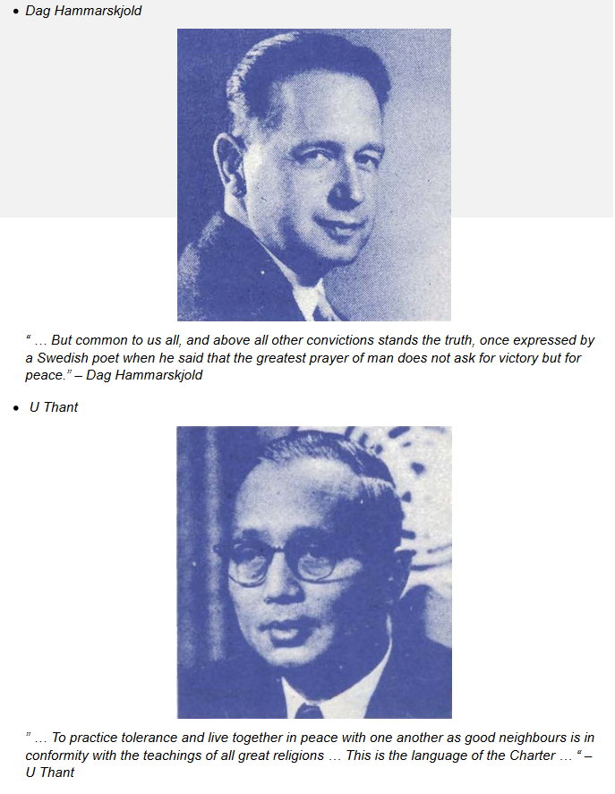
To the end I will love the United Nations part 2
Two things the UN
can do.
It can bravely
speak out and
say what it feels
is the right thing
to say, and
13 March 2005, Sri Chinmoy, His Compassion is everything to us, Agni Press, 2013

Slide 55
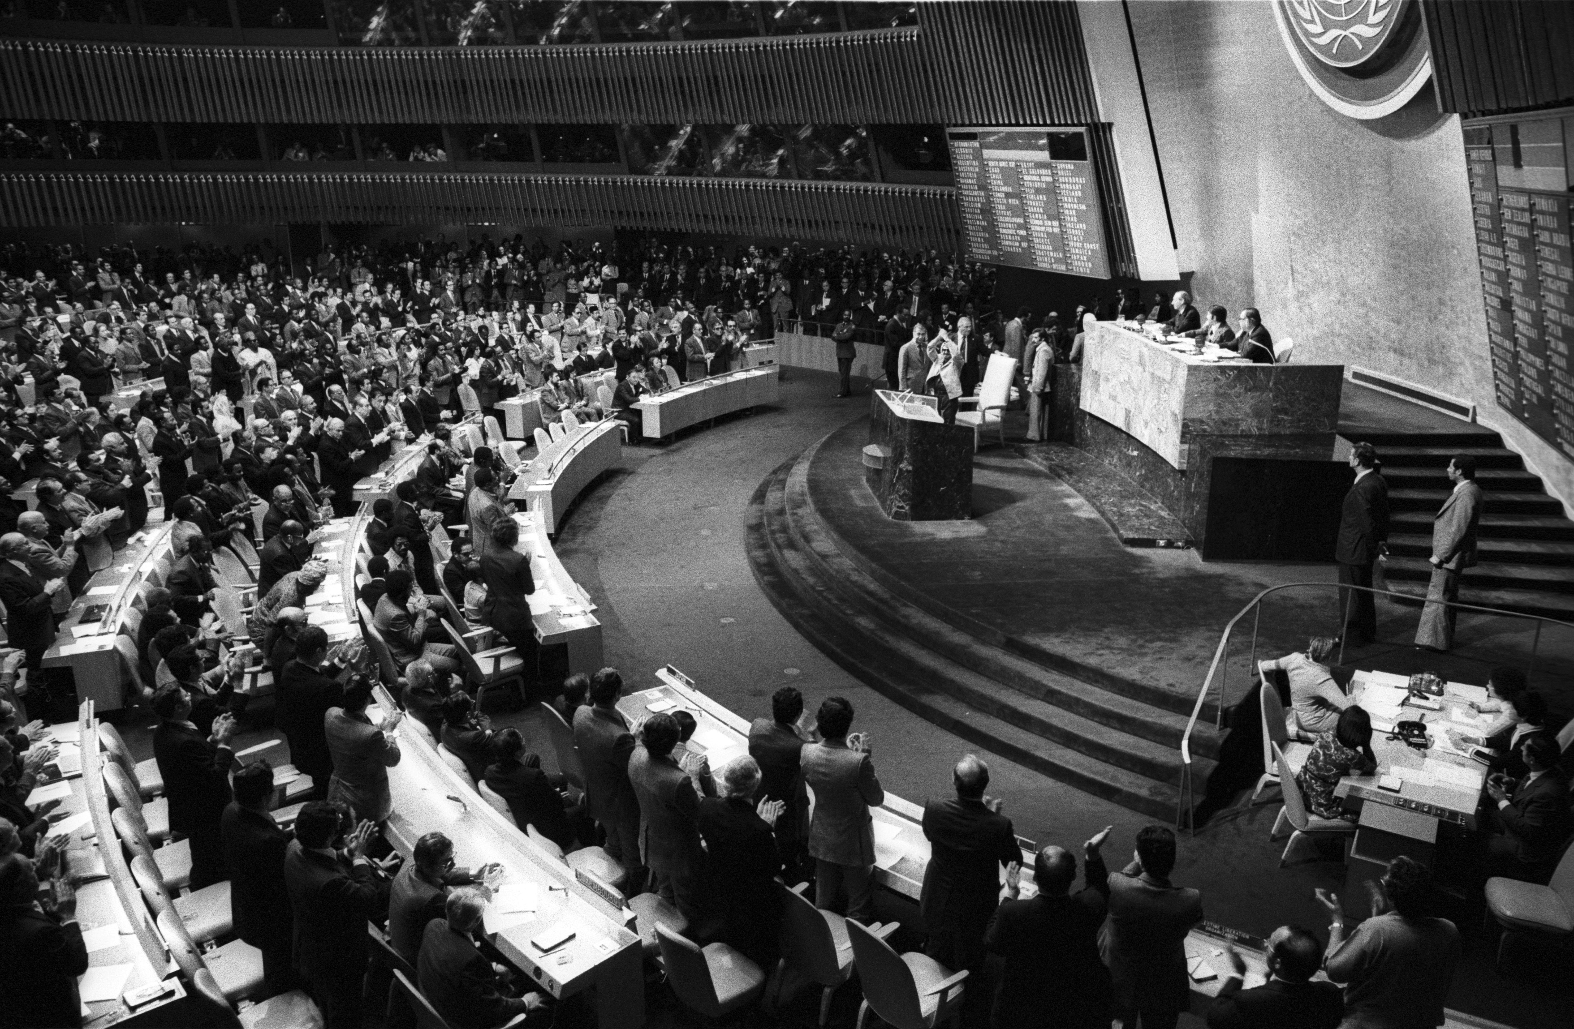
at the same time it can
beg the world
to come to its rescue.
It can also unreservedly
take advice
from the nations
that are most
sincerely
ready and
eager to help….
UN-General Assembly during 29th Session. UN photo-245849

Slide 56
To the end I will love the United Nations part 3
To the end I will love and
love the United Nations.
One good word if I hear
about the United Nations,
I literally
dance in the sky.
13 March 2005, Sri Chinmoy, His Compassion is everything to us, Agni Press, 2013

